Slide 1

Principles of
Operating System
CPU Schedule Ⅱ

Slide 2


Roadmap
Basic Concepts
Scheduling Criteria
Scheduling Algorithms
Multiple-Processor Scheduling
Real-Time Scheduling
Algorithm Evaluation

Slide 3
Multilevel Queue
Ready queue is partitioned into separate queues, for example:
  foreground (interactive)
  background (batch)
Each queue has its own scheduling algorithm, for example:
  foreground – RR
  background – FCFS

Slide 4

Multilevel Queue Scheduling

Slide 5
Multilevel Queue (cont.)
Scheduling must be done between the queues.
  Fixed priority scheduling; (i.e., serve all from foreground then from background). Possibility of starvation.
  Time slice – each queue gets a certain amount of CPU time which it can schedule among its processes; i.e.:
    80% to foreground in RR
    20% to background in FCFS

Slide 6
Multilevel Feedback Queue
Multilevel feedback queue scheduling allows a process to move between queues.
The idea is to separate processes with different CPU-burst characteristics.
  If a process uses too much CPU time, it will be moved to a lower-priority queue.
  A process that waits too long in a lower-priority queue may be moved to a higher-priority queue.

Slide 7

Example of Multilevel Feedback Queue
Three queues:
  Q₀ – time quantum 8 milliseconds
  Q₁ – time quantum 16 milliseconds
  Q₂ – FCFS
Scheduling
  A new job enters queue Q₀ which is served FCFS. When it gains CPU, job receives 8 milliseconds. If it does not finish in 8 milliseconds, job is moved to queue Q₁.
  At Q₁ job is again served FCFS and receives 16 additional milliseconds. If it still does not complete, it is preempted and moved to queue Q₂.

Slide 8
Multilevel Feedback Queue (cont.)
Multilevel-feedback-queue scheduler defined by the following parameters:
  number of queues
  scheduling algorithms for each queue
  method used to determine when to upgrade a process
  method used to determine when to demote a process
  method used to determine which queue a process will enter when that process needs service

Slide 9
Roadmap
Basic Concepts
Scheduling Criteria
Scheduling Algorithms
Multiple-Processor Scheduling
Real-Time Scheduling
Algorithm Evaluation

Slide 10
Multiple-Processor Scheduling
CPU scheduling more complex when multiple CPUs are available.
Homogeneous processors within a multiprocessor.
Load sharing
Asymmetric multiprocessing – only one processor accesses the system data structures.

Slide 11
Roadmap
Basic Concepts
Scheduling Criteria
Scheduling Algorithms
Multiple-Processor Scheduling
Real-Time Scheduling
Algorithm Evaluation

Slide 12
Real-Time Scheduling
Hard real-time systems – required to complete a critical task within a guaranteed amount of time.
Soft real-time computing – requires that critical processes receive priority over less fortunate ones.

Slide 13
Roadmap
Basic Concepts
Scheduling Criteria
Scheduling Algorithms
Multiple-Processor Scheduling
Real-Time Scheduling
Algorithm Evaluation

Slide 14
Algorithm Evaluation
To select a scheduling algorithm, we must first define the criteria to be used and the relative importance of these criteria.
Some general evaluation methods are:
  Deterministic modeling
  Queuing models
  Simulations
  Implementation

Slide 15
Deterministic Modeling
Analytic evaluation: one major class of evaluation methods
  It uses the given algorithm and the system workload to produce a formula or number that evaluates the performance of the algorithm for that workload.
Deterministic modeling: one type of analytic evaluation.
  Takes a particular predefined workload and defines the performance of each algorithm for that workload.

Slide 16
Example of Deterministic Modeling
Process Burst time
P₁ 10
P₂ 29
P₃ 3
P₄ 7
P₅ 12
Average waiting time:
  FCFS: (0+10+39+42+49)/5=28ms
  Non-preemptive SJF: (10+32+0+3+20)/5=13ms
  RR(10): (0+32+20+23+40)/5=23ms
Conclusion: SJF results in less than one-half the average waiting time of FCFS, while RR gives an intermediate value.

Slide 17
Features of Deterministic Modeling
Advantages
  Deterministic modeling is simple and fast.
  It gives exact numbers, allowing the algorithms to be compared.
Disadvantages
  It requires exact numbers for input, and its answers apply to only those cases.
Usage: describing scheduling algorithms and providing examples.
Limitation: too specific and requires too much exact knowledge.

Slide 18
Queuing Models
Queuing-network analysis
  The computer system is described as a network of servers.
  Each server has a queue of waiting process.
  The CPU is a server with its ready queue, as is the I/O system with its device queues.
  Knowing arrival rates and service rates, we can compute utilization, average queue length, average wait time, and so on.

Slide 19
Example of Queuing models
Let n be the average queue length, let w be the average waiting time in the queue, and let λ be the average arrival rate for new processes in the queue.
Expect
  During the time w that a process waits, w×λ new processes will arrive in the queue.
  If the system is in a steady state, the number of processes leaving the queue must be equal to the number of processes that arrive.
n= w×λ -- Little’s formula

Slide 20
Features of queuing models
Advantages
  Useful in comparing scheduling algorithms.
Disadvantages
  The classes of algorithms and distributions that can be handled are fairly limited.
  The mathematics of complicated algorithms or distributions can be difficult to work with.
  Generally need a number of independent assumptions, that may not be accurate.

Slide 21

Simulation
To get a more accurate evaluation of scheduling algorithms, we can use simulation.
Useful but expensive.
program a model of the computer system

Slide 22
Implementation
Even a simulation is of limited accuracy, the only completely accurate way to evaluate a scheduling algorithm is implementation:
  To code the algorithm,
  To put it in the OS,
  To see how it works.
Major difficulty is the cost of this approach:
  A perfect scheduling algorithm is not easy to found.
  In practice, we don’t really need the perfect scheduling algorithm.

Slide 23
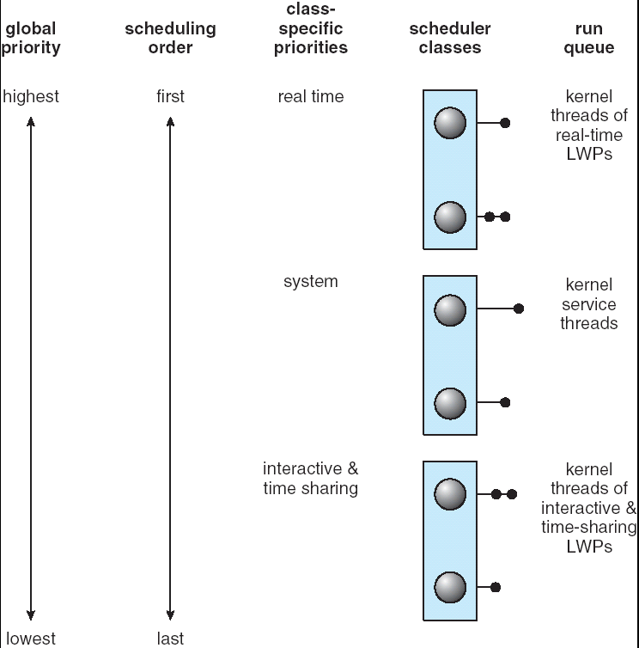
Solaris Scheduling: Priority-Based

Slide 24
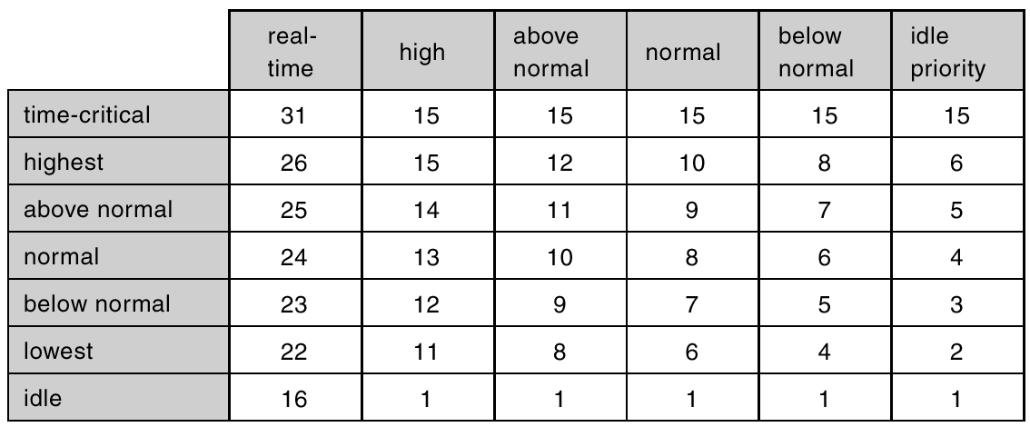
Windows 2000/XP Priorities

Slide 25
Linux
A variaion of the traditional UNIX scheduling algorithm.
Unlike other systems, Linux assigns higher-priority tasks longer time quanta and lower-priority tasks shorter time quanta.

Slide 26
Test!

Slide 27
Homework
Consider the following set of processes, with the length of the CPU-burst time given in milliseconds:
process burst time priority arrive
P₁ 10 3 0
P₂ 1 1 1
P₃ 2 3 2
P₄ 1 4 3
P₅ 5 2 4
The processes are assumed to have arrived in the order P₁, P₂, P₃, P₄, P₅, all at time 0.
a. Draw four Gantt charts illustrating the execution of these processes using FCFS, preemptive SJF, a preemptive priority (smaller priority implies higher priority), and RR (quantum=2) scheduling
b. What is the turnaround time of each process for each of the scheduling algorithms in part a
c. What is the waiting time of each process for each of the scheduling algorithms in part a
d. Which of the schedules in part a results in the minimal average waiting time (over all processes)

Slide 28
Keystone
How to evaluate different algorithms

Slide 29
Homework
Suppose that the following processes arrive for execution at the times indicated. Each process will run the listed amount of time. In answering the questions, use nonpreempive scheduling and base all decisions on the information you have at the time the decision must be made.
process arrival time burst time
P₁ 0.0 8
P₂ 0.4 4
P₃ 1.0 1
a. What is the average turnaround time for these processes with the FCFS scheduling algorithm
b. What is the average turnaround time for these processes with the SJF scheduling algorithm
c. Compute what the average turnaround time will be if the CPU is left idle for the first 1 unit and them SJF scheduling is used.

Slide 30
Homework
What advantage is there in having different time-quantum sizes on different levels of a multilevel queueing system
Explain the differences in the degree to which the following scheduling algorithms discriminate in favor of short processes:
  FCFS
  RR
  Multilevel feedback queues

Slide 31
Principles of
Operating System
End of CPU Schedule Ⅱ

